Slide 1
利用SCI助力科研论文检索写作与投稿
07 NOV 2017 中国海洋大学
王硕
手机：18710078551
邮箱：s.wang@clarivate.com
微信：494938351

Slide 2
提纲
什么是Web of Science（SCIE/SSCI）
硕博士生开题小案例
Web of Science高级应用
论文管理和写作
SCI期刊选择和投稿

Slide 3
SCI(Science Citation Index)的前世今生
Dr. Garfield 1955年在 Science 发表论文提出将引文索引作为一种新的文献检索与分类工具，将一篇文献作为检索字段从而跟踪一个“Idea”的发展过程
^{Synthesis of Amino Acids}
Synthesis and/or collection of Synthesis and/or collection of amino acids is critical for cell survival. They not only serve as the building blocks for proteins but also as starting points for the synthesis of many important cellular molecules including vitamins and nucleotides.
^{Synthesis of Amino Acids}
Synthesis and/or collection of Synthesis and/or collection of amino acids is critical for cell survival. They not only serve as the building blocks for proteins but also as starting points for the synthesis of many important cellular molecules including vitamins and nucleotides.
^{Synthesis of Amino Acids}
Synthesis and/or collection of Synthesis and/or collection of amino acids is critical for cell survival. They not only serve as the building blocks for proteins but also as starting points for the synthesis of many important cellular molecules including vitamins and nucleotides.
^{Synthesis of Amino Acids}
Synthesis and/or collection of Synthesis and/or collection of amino acids is critical for cell survival. They not only serve as the building blocks for proteins but also as starting points for the synthesis of many important cellular molecules including vitamins and nucleotides.
^{Synthesis of Amino Acids}
Synthesis and/or collection of Synthesis and/or collection of amino acids is critical for cell survival. They not only serve as the building blocks for proteins but also as starting points for the synthesis of many important cellular molecules including vitamins and nucleotides.
^{Synthesis of Amino Acids}
Synthesis and/or collection of Synthesis and/or collection of amino acids is critical for cell survival. They not only serve as the building blocks for proteins but also as starting points for the synthesis of many important cellular molecules including vitamins and nucleotides.
^{Synthesis of Amino Acids}
Synthesis and/or collection of Synthesis and/or collection of amino acids is critical for cell survival. They not only serve as the building blocks for proteins but also as starting points for the synthesis of many important cellular molecules including vitamins and nucleotides.
^{Synthesis of Amino Acids}
Synthesis and/or collection of Synthesis and/or collection of amino acids is critical for cell survival. They not only serve as the building blocks for proteins but also as starting points for the synthesis of many important cellular molecules including vitamins and nucleotides.
^{Synthesis of Amino Acids}
Synthesis and/or collection of Synthesis and/or collection of amino acids is critical for cell survival. They not only serve as the building blocks for proteins but also as starting points for the synthesis of many important cellular molecules including vitamins and nucleotides.
^{Synthesis of Amino Acids}
Synthesis and/or collection of Synthesis and/or collection of amino acids is critical for cell survival. They not only serve as the building blocks for proteins but also as starting points for the synthesis of many important cellular molecules including vitamins and nucleotides.
Dr. Eugene Garfield
Founder & Chairman Emeritus ISI, Thomson Scientific
“Our ultimate goal is to extend our retrospective coverage of the scientific literature back to the twentieth century. The Century of Science initiative makes that dream come true.”
^{Synthesis of Amino Acids}
Synthesis and/or collection of Synthesis and/or collection of amino acids is critical for cell survival. They not only serve as the building blocks for proteins but also as starting points for the synthesis of many important cellular molecules including vitamins and nucleotides.
^{Synthesis of Amino Acids}
Synthesis and/or collection of Synthesis and/or collection of amino acids is critical for cell survival. They not only serve as the building blocks for proteins but also as starting points for the synthesis of many important cellular molecules including vitamins and nucleotides.
^{Synthesis of Amino Acids}
Synthesis and/or collection of Synthesis and/or collection of amino acids is critical for cell survival. They not only serve as the building blocks for proteins but also as starting points for the synthesis of many important cellular molecules including vitamins and nucleotides.
^{Synthesis of Amino Acids}
Synthesis and/or collection of Synthesis and/or collection of amino acids is critical for cell survival. They not only serve as the building blocks for proteins but also as starting points for the synthesis of many important cellular molecules including vitamins and nucleotides.
^{Synthesis of Amino Acids}
Synthesis and/or collection of Synthesis and/or collection of amino acids is critical for cell survival. They not only serve as the building blocks for proteins but also as starting points for the synthesis of many important cellular molecules including vitamins and nucleotides.
^{Synthesis of Amino Acids}
Synthesis and/or collection of Synthesis and/or collection of amino acids is critical for cell survival. They not only serve as the building blocks for proteins but also as starting points for the synthesis of many important cellular molecules including vitamins and nucleotides.
^{Synthesis of Amino Acids}
Synthesis and/or collection of Synthesis and/or collection of amino acids is critical for cell survival. They not only serve as the building blocks for proteins but also as starting points for the synthesis of many important cellular molecules including vitamins and nucleotides.
^{Synthesis of Amino Acids}
Synthesis and/or collection of Synthesis and/or collection of amino acids is critical for cell survival. They not only serve as the building blocks for proteins but also as starting points for the synthesis of many important cellular molecules including vitamins and nucleotides.
^{Synthesis of Amino Acids}
Synthesis and/or collection of Synthesis and/or collection of amino acids is critical for cell survival. They not only serve as the building blocks for proteins but also as starting points for the synthesis of many important cellular molecules including vitamins and nucleotides.
^{Synthesis of Amino Acids}
Synthesis and/or collection of Synthesis and/or collection of amino acids is critical for cell survival. They not only serve as the building blocks for proteins but also as starting points for the synthesis of many important cellular molecules including vitamins and nucleotides.
^{Synthesis of Amino Acids}
Synthesis and/or collection of Synthesis and/or collection of amino acids is critical for cell survival. They not only serve as the building blocks for proteins but also as starting points for the synthesis of many important cellular molecules including vitamins and nucleotides.
^{Synthesis of Amino Acids}
Synthesis and/or collection of Synthesis and/or collection of amino acids is critical for cell survival. They not only serve as the building blocks for proteins but also as starting points for the synthesis of many important cellular molecules including vitamins and nucleotides.
^{Synthesis of Amino Acids}
Synthesis and/or collection of Synthesis and/or collection of amino acids is critical for cell survival. They not only serve as the building blocks for proteins but also as starting points for the synthesis of many important cellular molecules including vitamins and nucleotides.
^{Synthesis of Amino Acids}
Synthesis and/or collection of Synthesis and/or collection of amino acids is critical for cell survival. They not only serve as the building blocks for proteins but also as starting points for the synthesis of many important cellular molecules including vitamins and nucleotides.
^{Synthesis of Amino Acids}
Synthesis and/or collection of Synthesis and/or collection of amino acids is critical for cell survival. They not only serve as the building blocks for proteins but also as starting points for the synthesis of many important cellular molecules including vitamins and nucleotides.
^{Synthesis of Amino Acids}
Synthesis and/or collection of Synthesis and/or collection of amino acids is critical for cell survival. They not only serve as the building blocks for proteins but also as starting points for the synthesis of many important cellular molecules including vitamins and nucleotides.
^{Synthesis of Amino Acids}
Synthesis and/or collection of Synthesis and/or collection of amino acids is critical for cell survival. They not only serve as the building blocks for proteins but also as starting points for the synthesis of many important cellular molecules including vitamins and nucleotides.
^{Synthesis of Amino Acids}
Synthesis and/or collection of Synthesis and/or collection of amino acids is critical for cell survival. They not only serve as the building blocks for proteins but also as starting points for the synthesis of many important cellular molecules including vitamins and nucleotides.
^{Synthesis of Amino Acids}
Synthesis and/or collection of Synthesis and/or collection of amino acids is critical for cell survival. They not only serve as the building blocks for proteins but also as starting points for the synthesis of many important cellular molecules including vitamins and nucleotides.

Slide 4
Web of Science Core Collection
Science Citation Index Expanded(科学引文索引，SCIE）: 8800+种核心期刊，可回溯到1900年
Social Science Citation Index(社会科学引文索引，SSCI）：3200+种核心期刊，可回溯到1900年
Arts & Humanities Citation Index(艺术与人文索引AHCI）: 1600+种核心期刊，可回溯到1975年
Conference Proceedings Citation Index - Science (CPCI-S)--1990-至今
Conference Proceedings Citation Index - Social Science & Humanities (CPCI-SSH)--1990-至今

Slide 5
Question

Slide 6
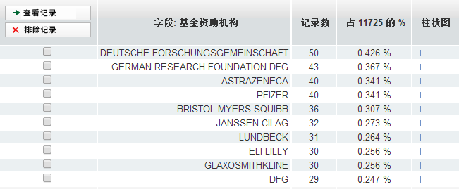
慕尼黑大学某课题组科研论文主要基金资助机构

Slide 7
德国科学基金会

Slide 8
瑞士国家科学基金会

Slide 9
Question

Slide 10
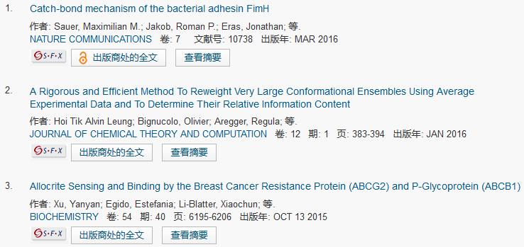
Simon Berneche
Notes:
三个方面，找导师，找科研伙伴，引进人才

Slide 11
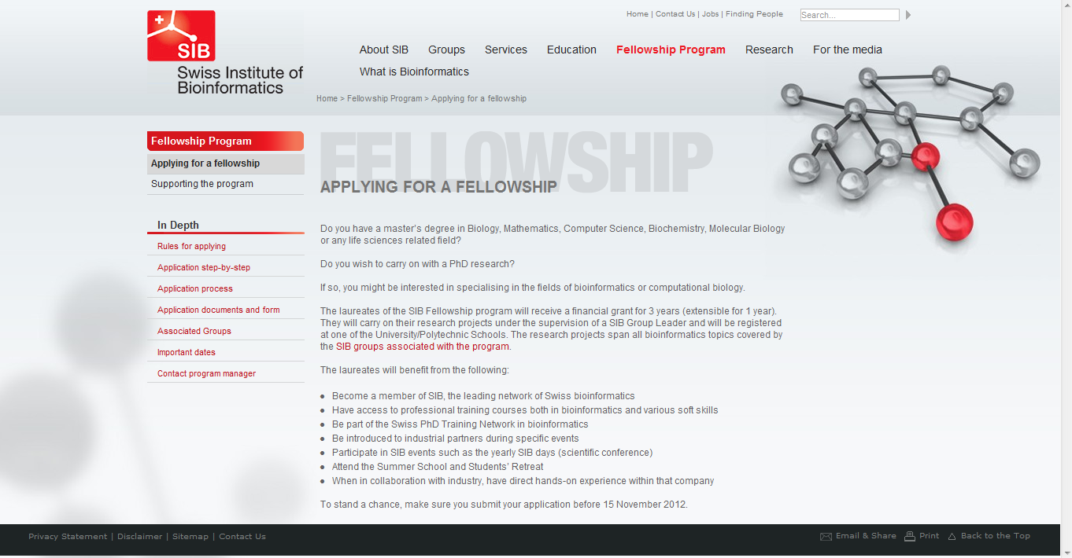
对于专业性很强的领域，国外也有很多基金

Slide 12
Question
为什么我在实验室里找不到女朋友呢？
为什么我一读文献就困呢？
Notes:
问大家了，大家在科研过程中会遇到什么问题。大家想好了可以不用举手，用意念传给我。第一条问题我已经收到了，说做实验没有课余时间，找不到漂亮的女朋友。好这个问题我会向贵校招生办的老师反映。好还有很多问题我们不一一罗列了，我之前在其他学校的讲座也收集了很多学生和老师的问题，在这里啊，我举一个如何开题查找文献的例子。

Slide 14
硕博士生开题选题小故事之——少儿肥胖症

Slide 15
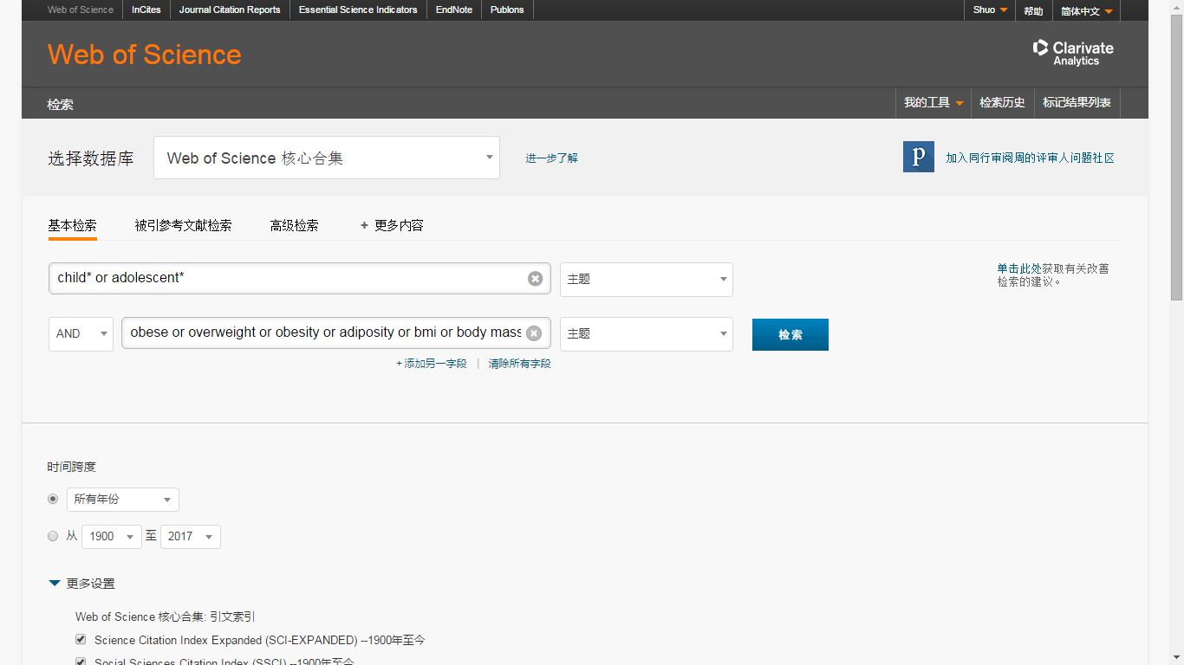
Webofscience.com

Slide 16
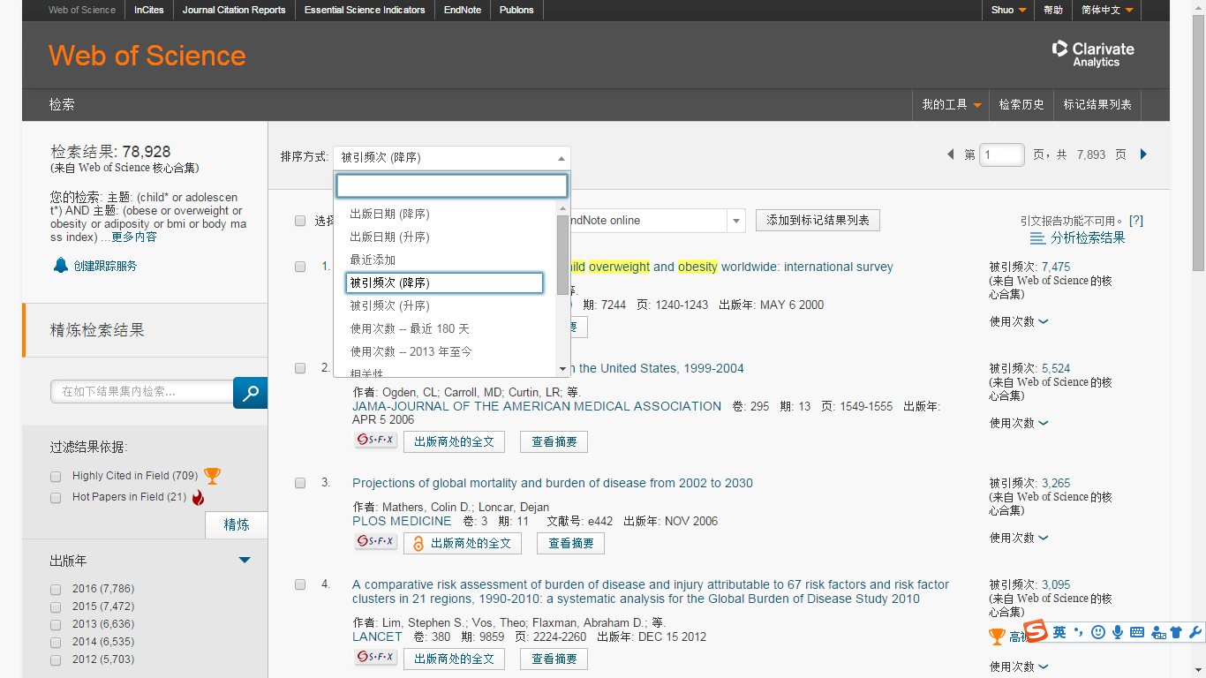
检索结果较多，先看哪些？重点看哪些？
Notes:
前一阵子听一个同学和我说，看文献碰到的最悲剧的事情不是一片文献看不懂，而是发现看到一片文献题目，觉得还不错准备下载的时候，系统提示说文件已存在。

Slide 18
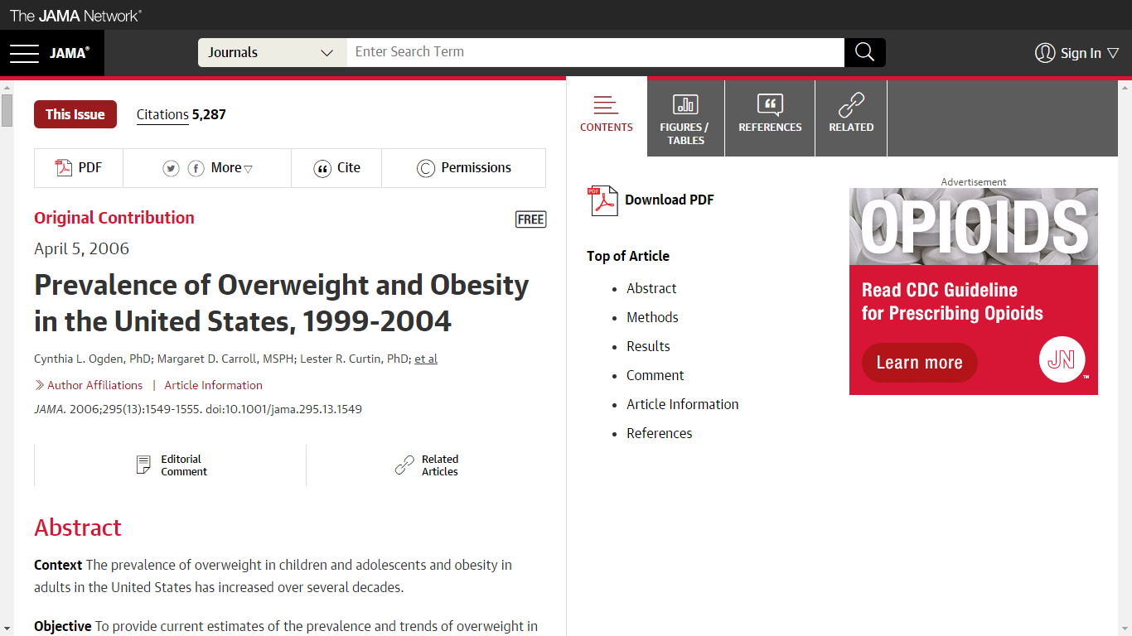
近年来，xxx越来越受到关注/xxx问题愈发严峻/一些报告指出……

Slide 19
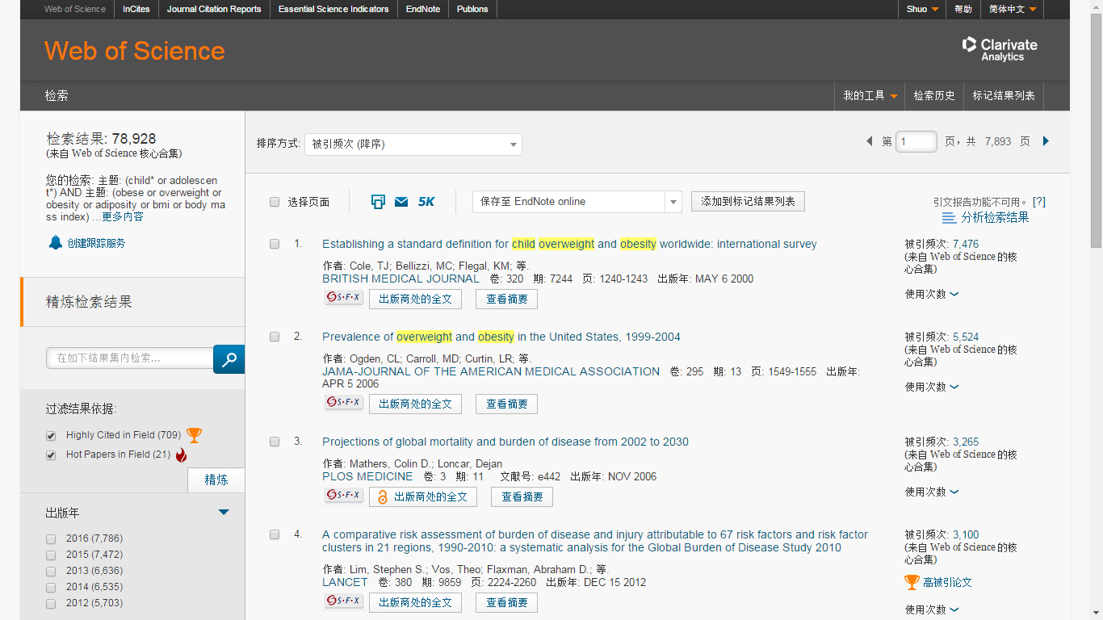
检索高被引及热点论文

Slide 20
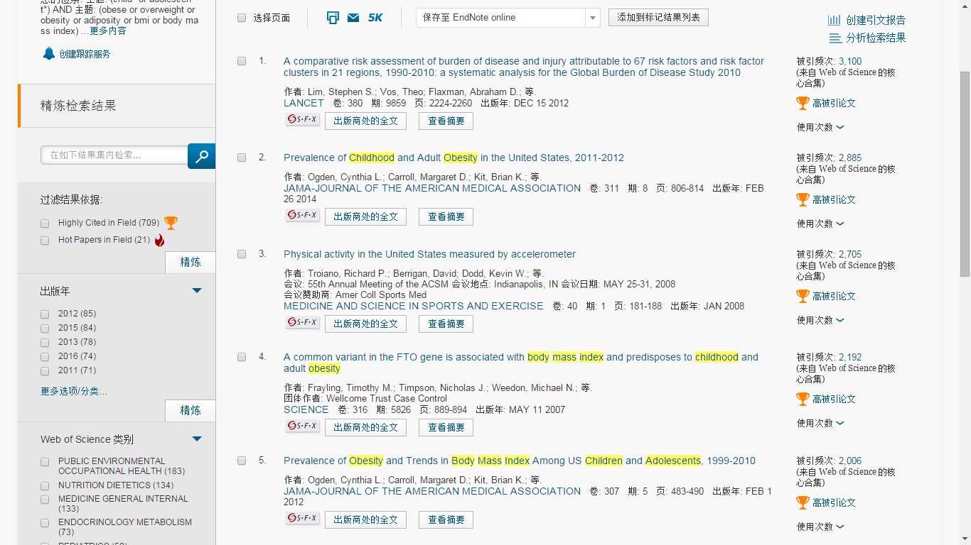

Slide 21
分析检索结果，大致了解课题方向

Slide 22
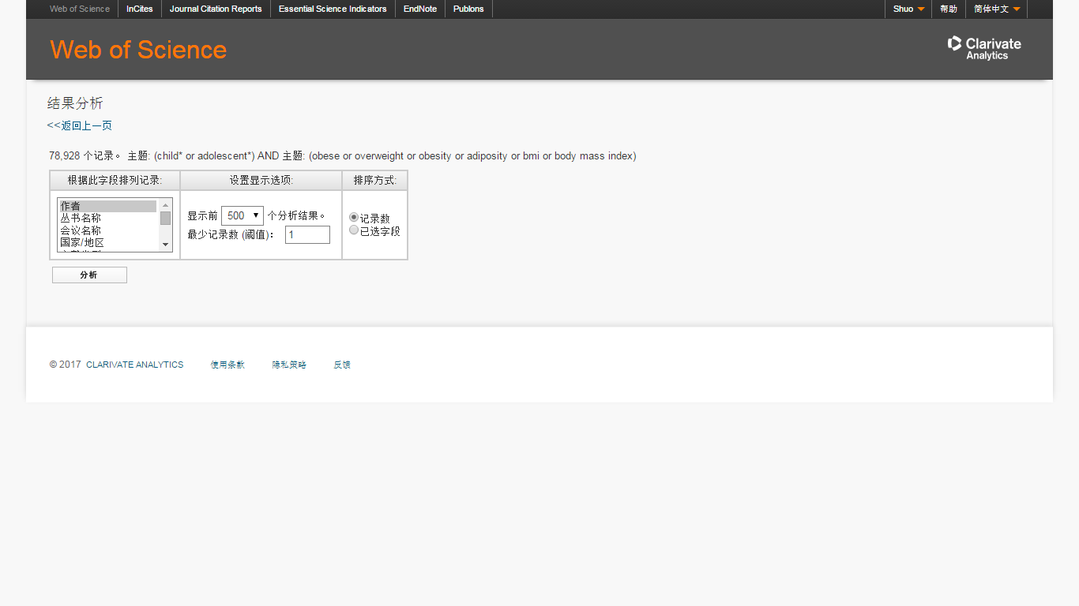
针对人员、期刊、学科、机构等16个字段分析

Slide 23
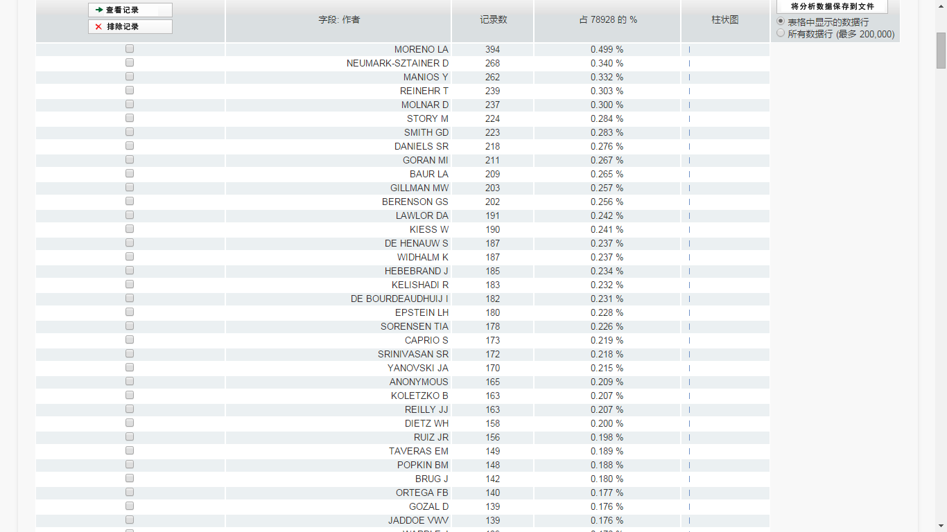
作者检索：发文量大的科研人员
Notes:
可以看到这几个作者啊，有点印象，之后还有他们的事情

Slide 24
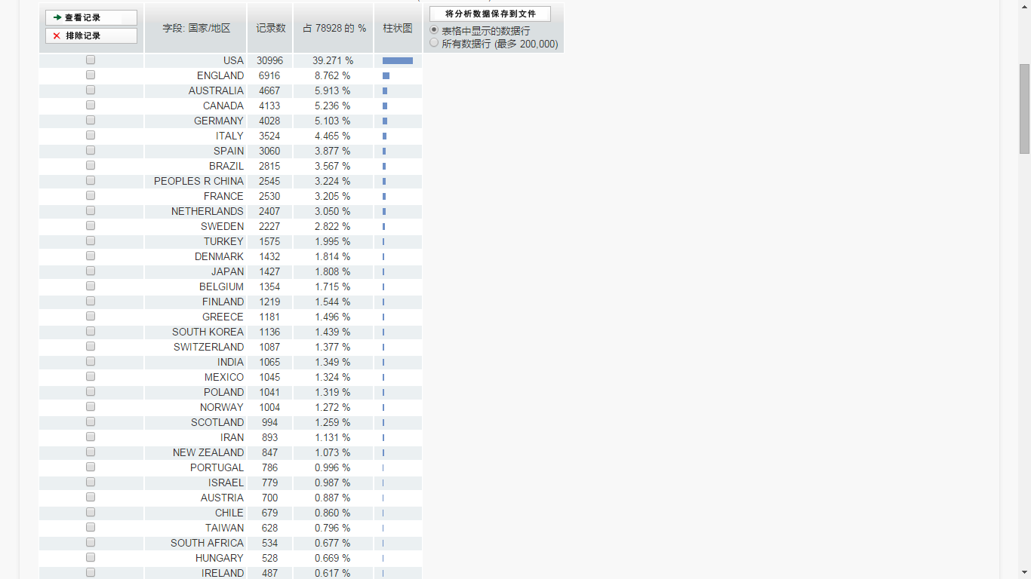
国家和地区检索
Notes:
美国领先幅度比较大，中国暂时排在第11位

Slide 25
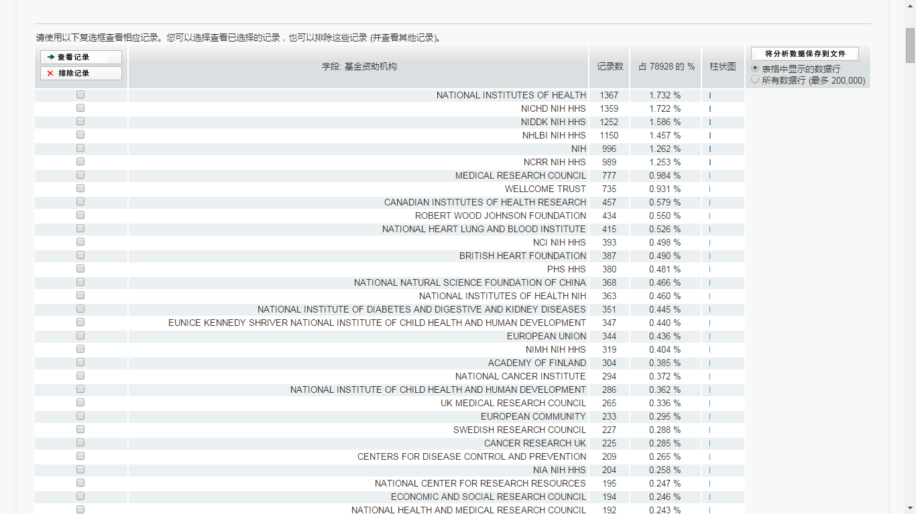
科研基金检索：

Slide 26
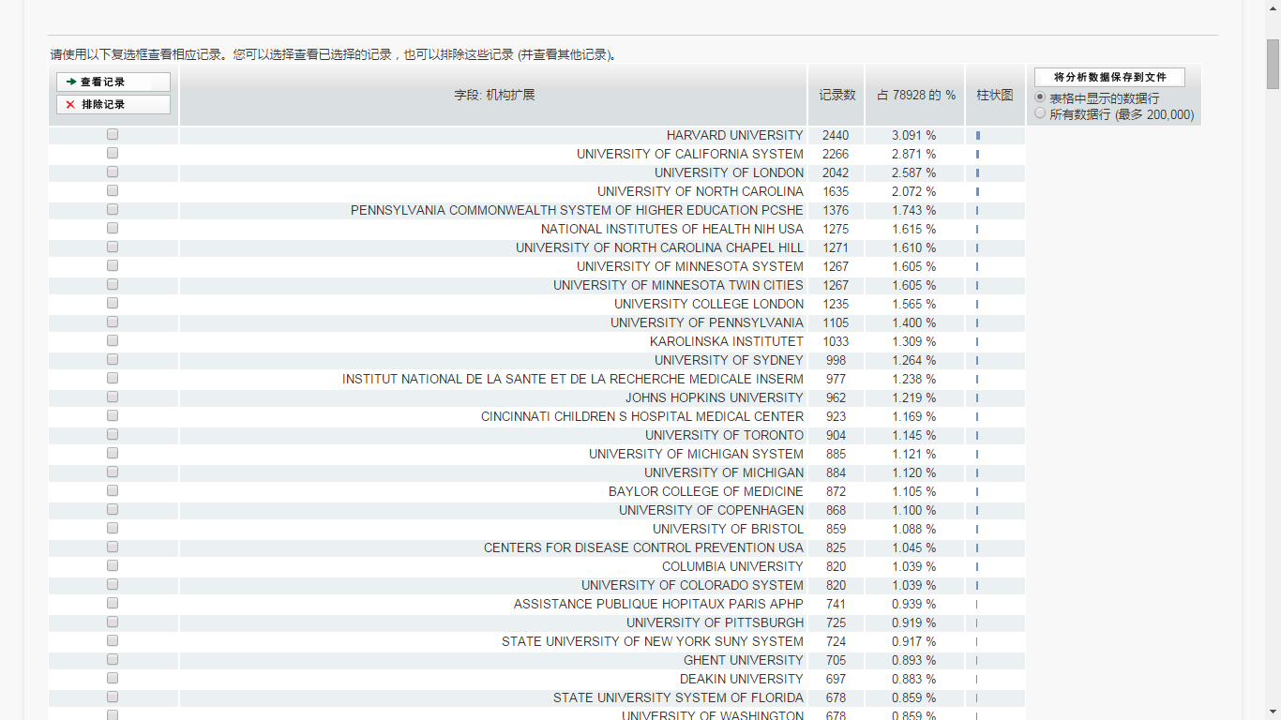
科研机构检索：为科研合作、学术交流作参考
Notes:
主要还是以国外的科研机构为主的，如何查看中国主要的科研机构呢

Slide 27
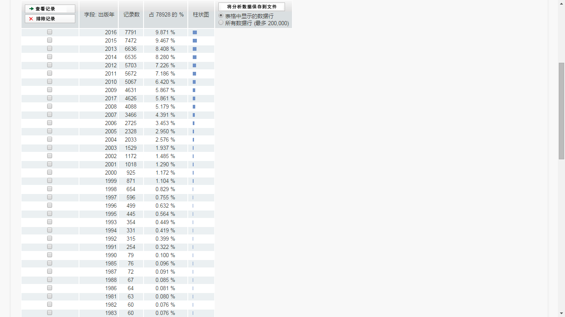
论文数量变化趋势

Slide 28
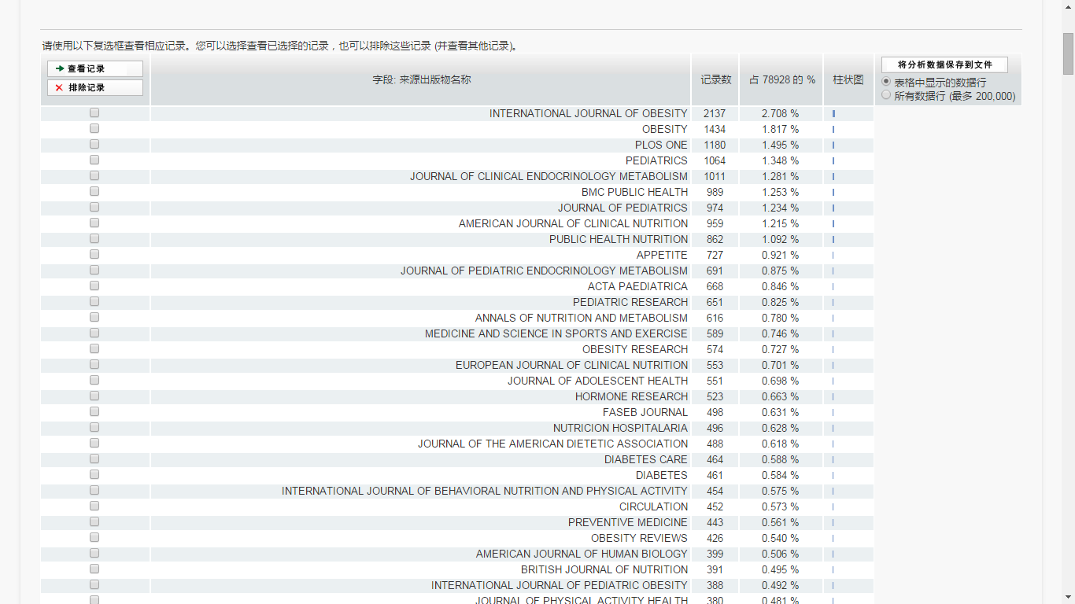
期刊检索
Notes:
通过期刊检索结果可以查看现有的文章都发表在了哪些期刊上，为老师们投稿有一个比较直观的印象。另外如果老师在科研一开始的时候就已经有一本目标刊物，可以专门对这本期刊发表的相应课题进行分析。提高投稿的成功率。

Slide 29
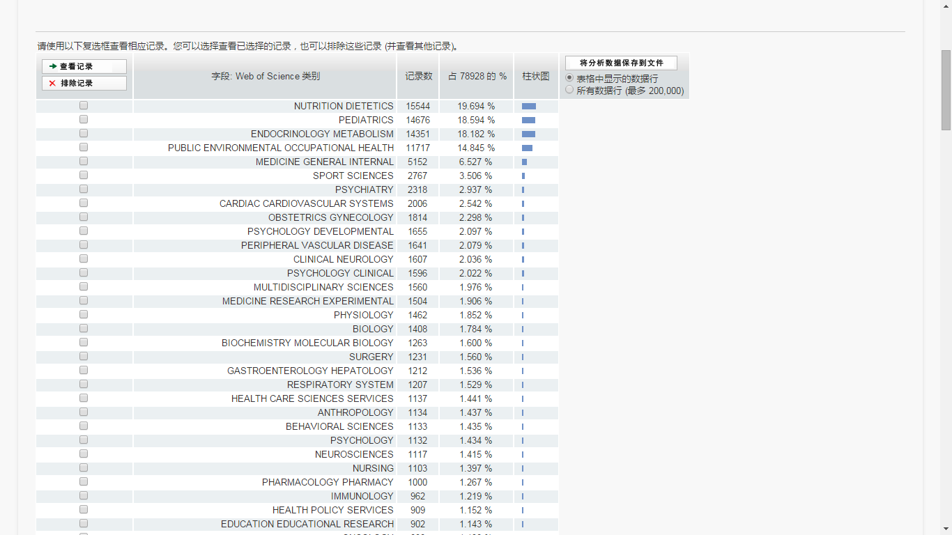
研究领域检索
Notes:
内分泌、代谢、营养学、糖尿病、手术治疗还是比较热门的研究方向

Slide 30
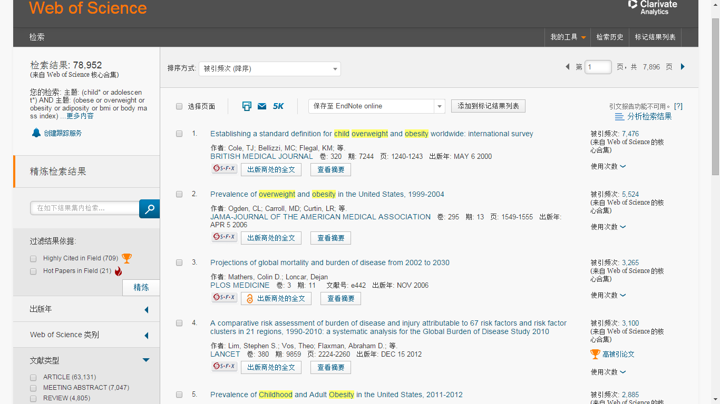
首先看一下核心科研人员的review

Slide 31
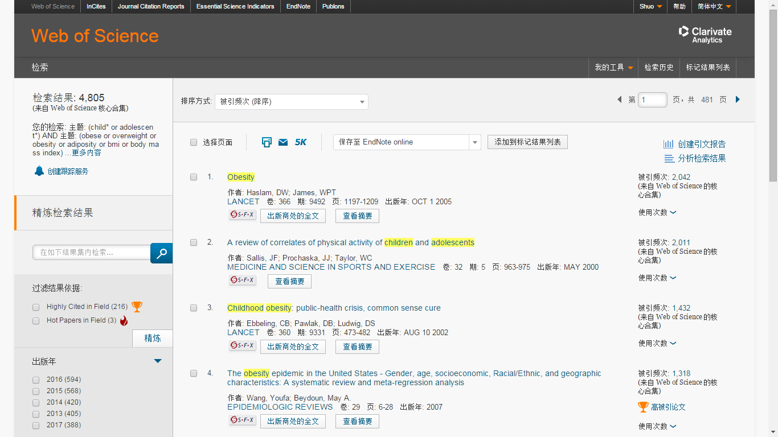
对于热门的研究课题，即使仅仅然Review数量依然很多
Notes:
1.按照被引用次数排序，可以看看高频被引文章2.再次分析检索结果

Slide 32
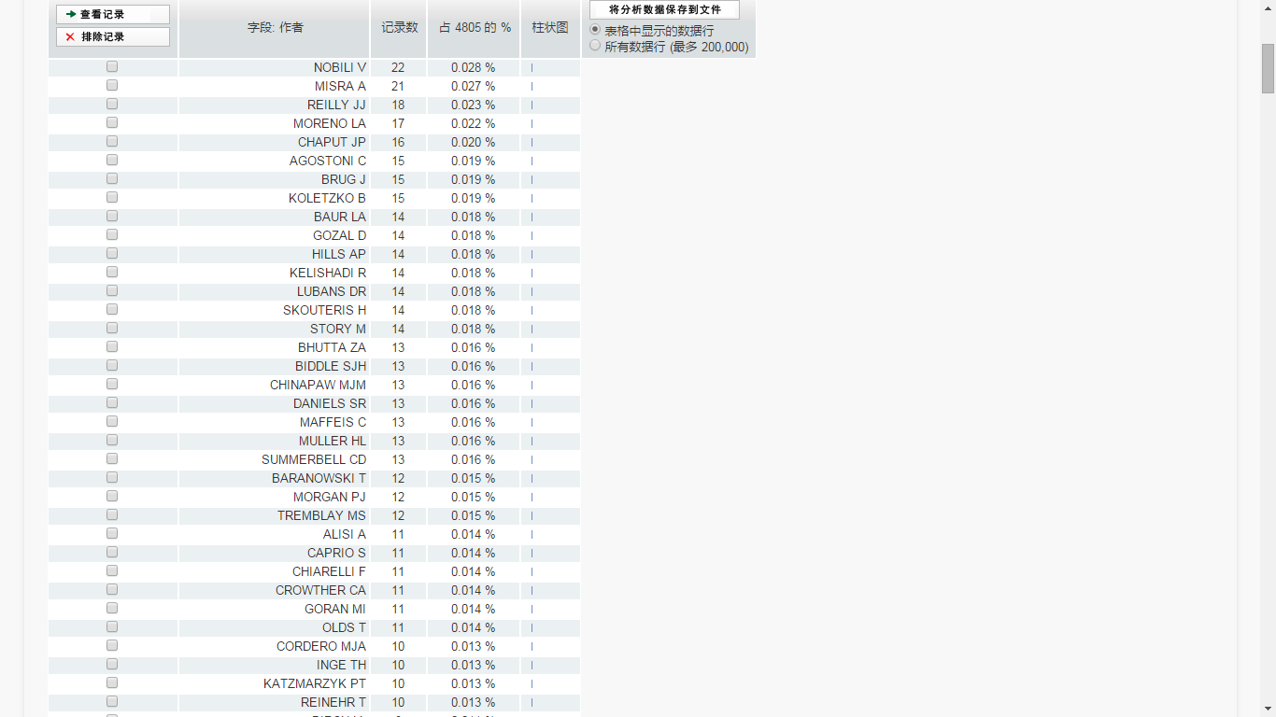
再次按照作者检索，可以看到刚才发文量较多的作者都在其中
Notes:
期刊也经常会向一个科研领域的核心研究人员来约稿。

Slide 33
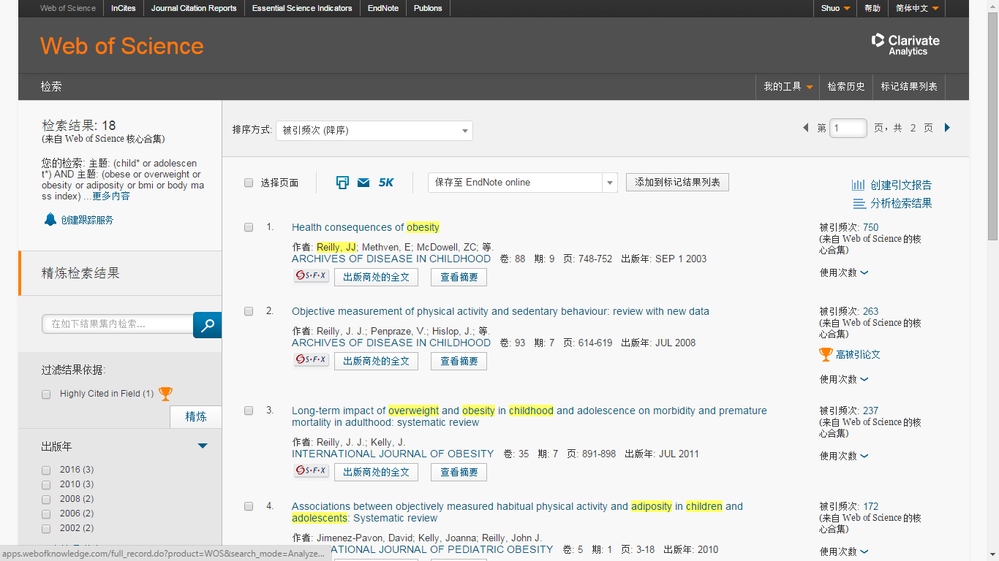
创建引文报告：从引用关系探索课题发展

Slide 34
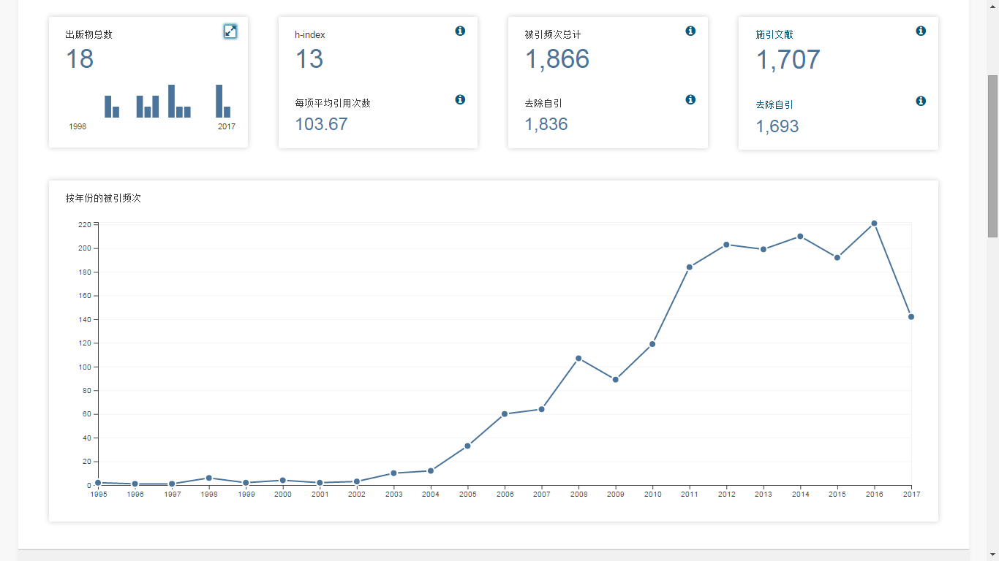

Slide 35
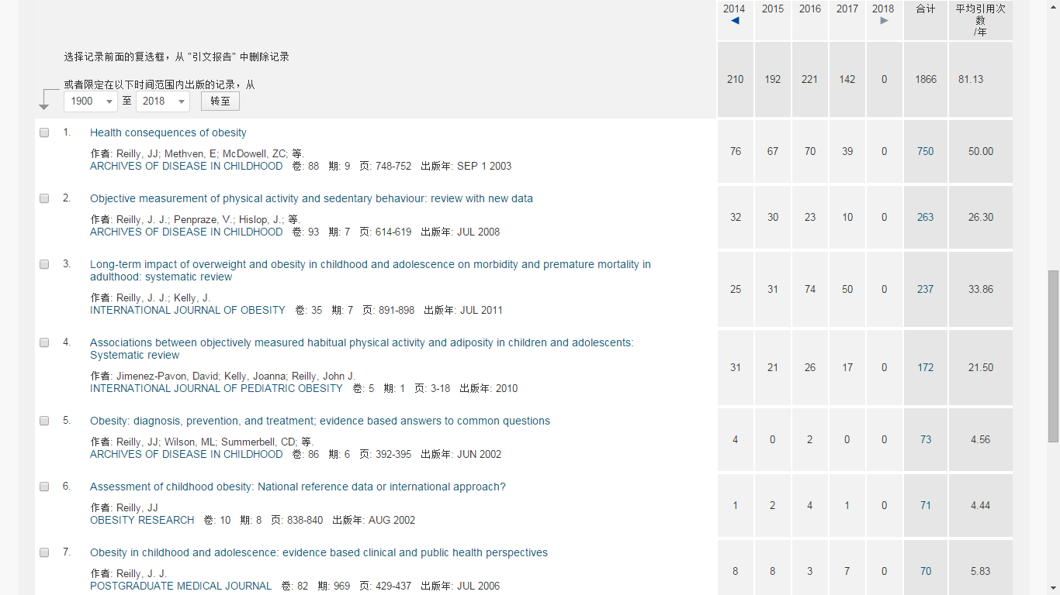
经典论文与热点论文
Notes:
核心研究人员的review会被大多数同领域的科研人员参考阅读，所以分析引用的文献就可以找到不同的科研方向。发表年限比较早且引用次数比较高的论文，通常是这个领域的经典的文章。对于了解其相关的发展是很有帮助的。相比于第一篇经典的文章，第二篇二章

Slide 36
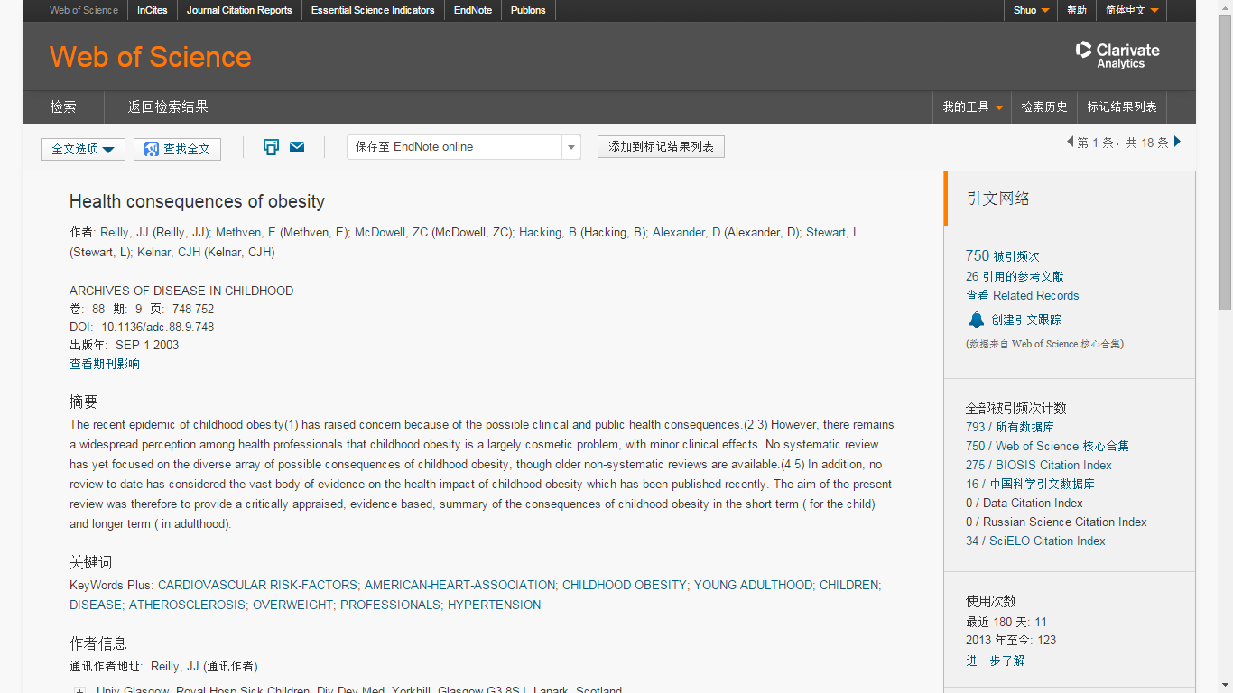
全记录界面
点击相应的记录数字就可以看这篇文献引用了哪些文献，以及被哪些文献引用
Notes:
各种功能先按下不表，重点来说一下引证关系

Slide 37
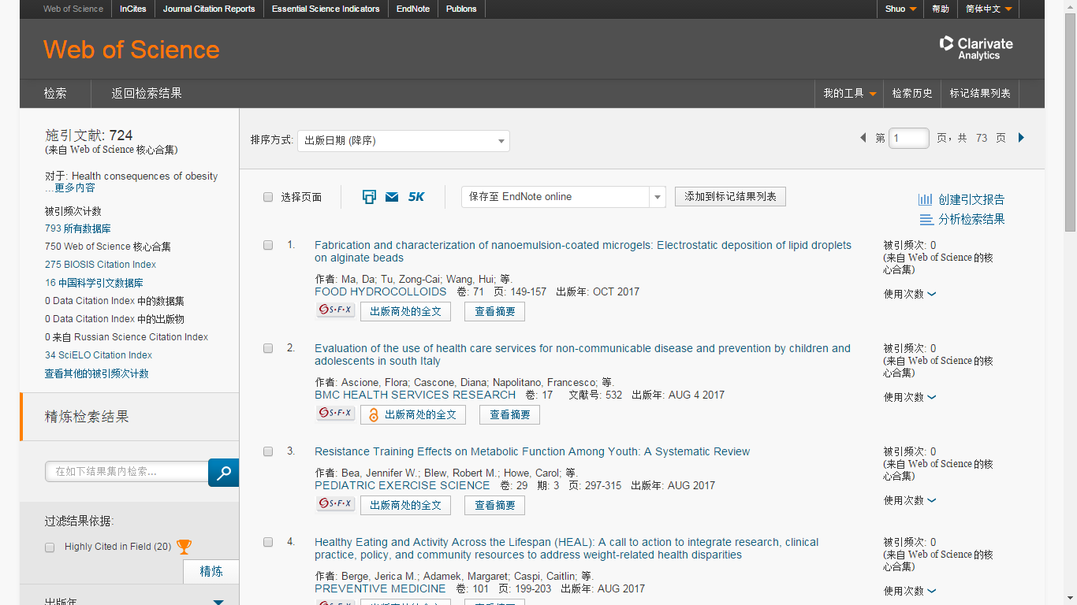
查看引用文献，再次创建引文报告

Slide 38
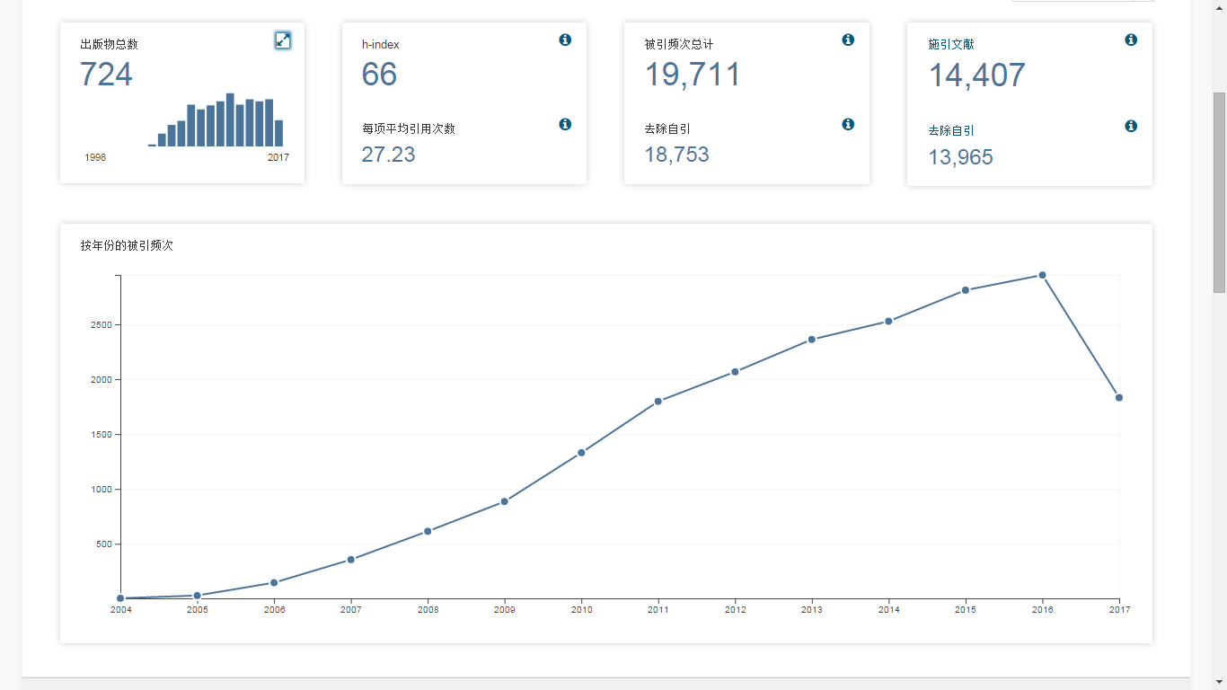

Slide 39
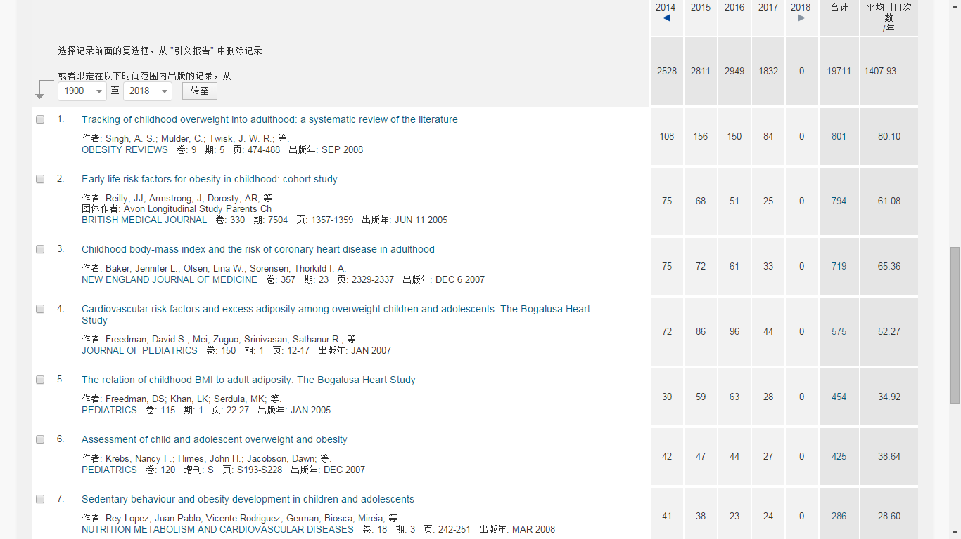

Slide 40
关于开题的小结
找大牛
大牛的牛综述
牛综述高影响力参考文献

Slide 41
挖掘Web of Science新平台更进一步的功能
创建引文跟踪/定题跟踪
相关记录
引证关系图
被引参考文献检索
Endnote
期刊影响因子

Slide 42
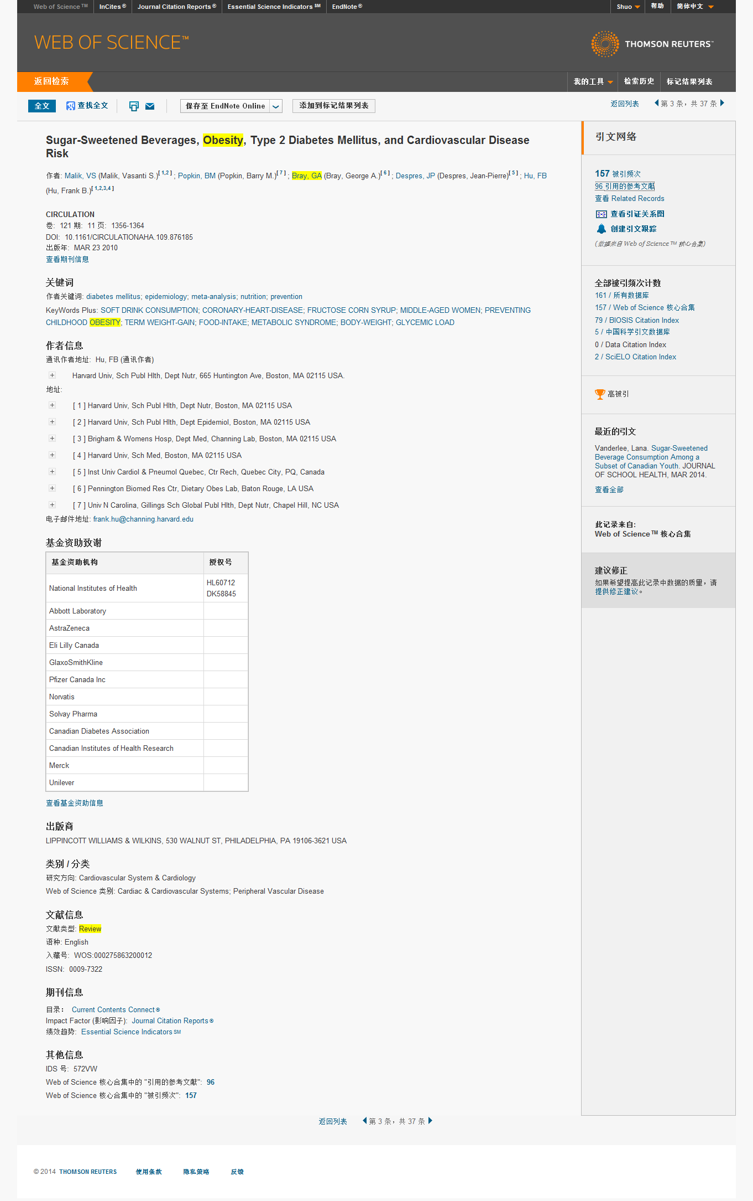
一篇文献全记录界面
Notes:
什么最吸引我呢，就是这个投稿人的邮箱。

Slide 43
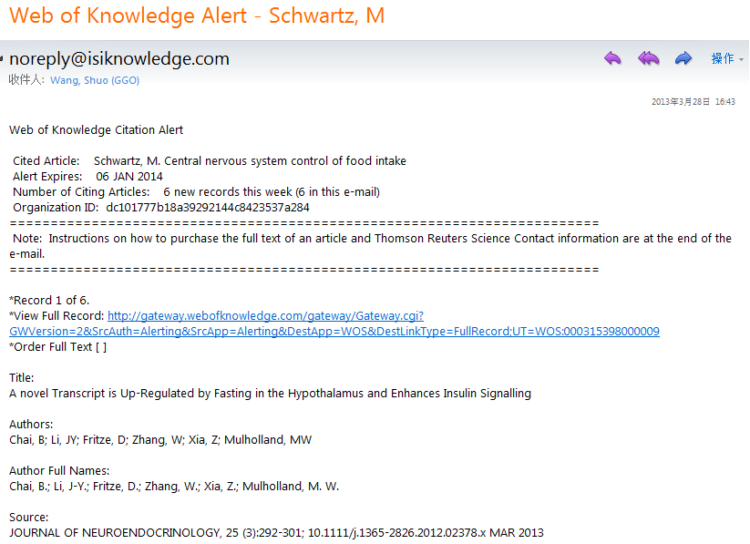

Slide 44
查看相关记录
Notes:
什么最吸引我呢，就是这个投稿人的邮箱。

Slide 45
如何理解Web of Science中的相关记录呢？
论文甲
论文乙
Synthesis of Amino Acids
Synthesis of Amino Acids
Synthesis and/or collection of Synthesis and/or collection of amino acids is critical for cell survival. They not only serve as the building blocks for proteins but also as starting points for the synthesis of many important cellular molecules including vitamins and nucleotides.
Synthesis and/or collection of Synthesis and/or collection of amino acids is critical for cell survival. They not only serve as the building blocks for proteins but also as starting points for the synthesis of many important cellular molecules including vitamins and nucleotides.
Synthesis of Amino Acids
Synthesis of Amino Acids
Synthesis of Amino Acids
Synthesis of Amino Acids
Synthesis of Amino Acids
Synthesis of Amino Acids
Synthesis and/or collection of Synthesis and/or collection of amino acids is critical for cell survival. They not only serve as the building blocks for proteins but also as starting points for the synthesis of many important cellular molecules including vitamins and nucleotides.
Synthesis and/or collection of Synthesis and/or collection of amino acids is critical for cell survival. They not only serve as the building blocks for proteins but also as starting points for the synthesis of many important cellular molecules including vitamins and nucleotides.
Synthesis and/or collection of Synthesis and/or collection of amino acids is critical for cell survival. They not only serve as the building blocks for proteins but also as starting points for the synthesis of many important cellular molecules including vitamins and nucleotides.
Synthesis and/or collection of Synthesis and/or collection of amino acids is critical for cell survival. They not only serve as the building blocks for proteins but also as starting points for the synthesis of many important cellular molecules including vitamins and nucleotides.
Synthesis and/or collection of Synthesis and/or collection of amino acids is critical for cell survival. They not only serve as the building blocks for proteins but also as starting points for the synthesis of many important cellular molecules including vitamins and nucleotides.
Synthesis and/or collection of Synthesis and/or collection of amino acids is critical for cell survival. They not only serve as the building blocks for proteins but also as starting points for the synthesis of many important cellular molecules including vitamins and nucleotides.
A B C D E F
Notes:
一些非热点学科可能本身文献量较少，但是可以通过相关记录拓展思路。

Slide 46
将文献记录按照相关值排序

Slide 47
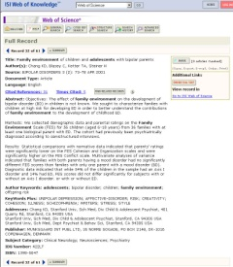
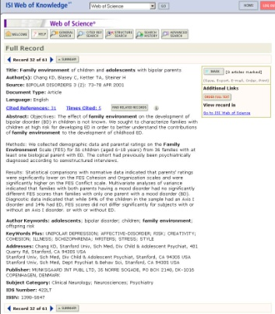
相关记录
一花一世界
从一篇高质量文献洞悉整个科研脉络
2004
…
2003
被引频次
2003
1998
2004
引用的参考文献
1995
1993
1991
2004
1980
← Citing ←
2002
被引频次：越查越新
引用的参考文献：越查越深
相关记录：越查越广
1999
1994
47
Notes:
47
讲到这里同学们对“引文”这个词有没有新的认识呢？

Slide 48
被引参考文献检索

Slide 49
如何保存喜欢的文章呢？
佛说，前世五百次回眸，才换来今世的擦肩而过。
遇到有缘的文章，千万不要错过……

Slide 50
登陆后，将目标文章保存至Endnote

Slide 51
Endnote

Slide 52
初识Endnote

Slide 53
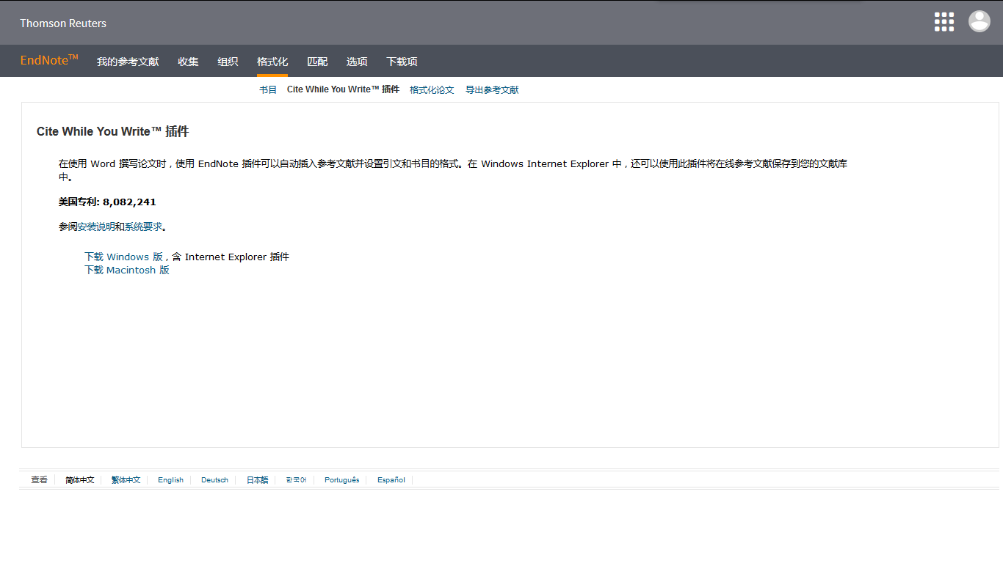
Word插件实现核心应用

Slide 54
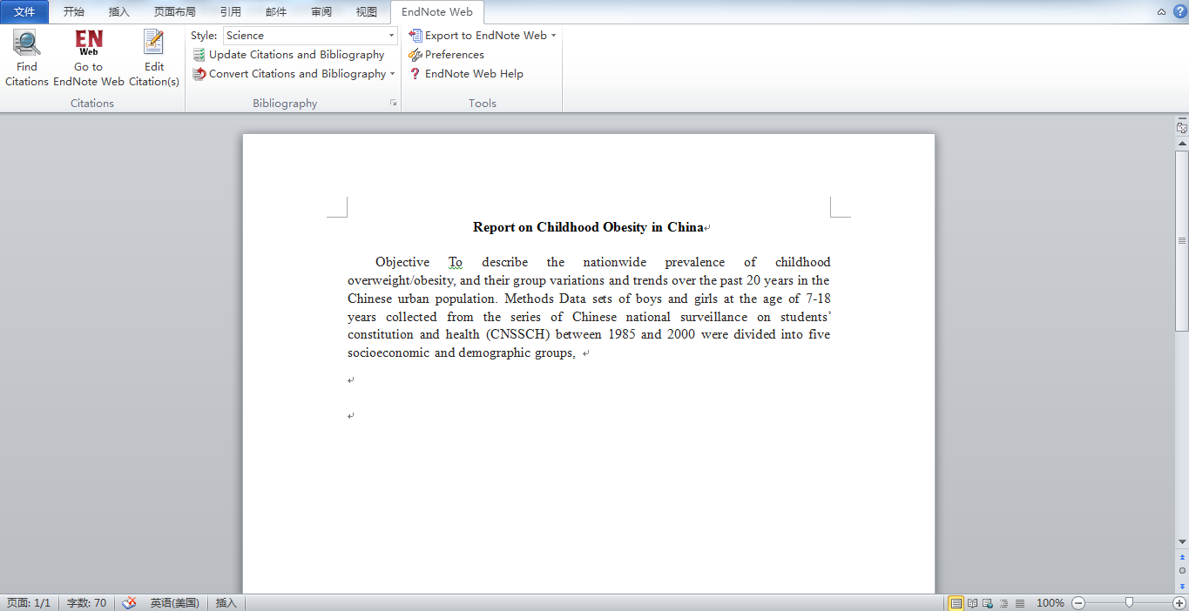
Endnote生成参考文献指南

Slide 55
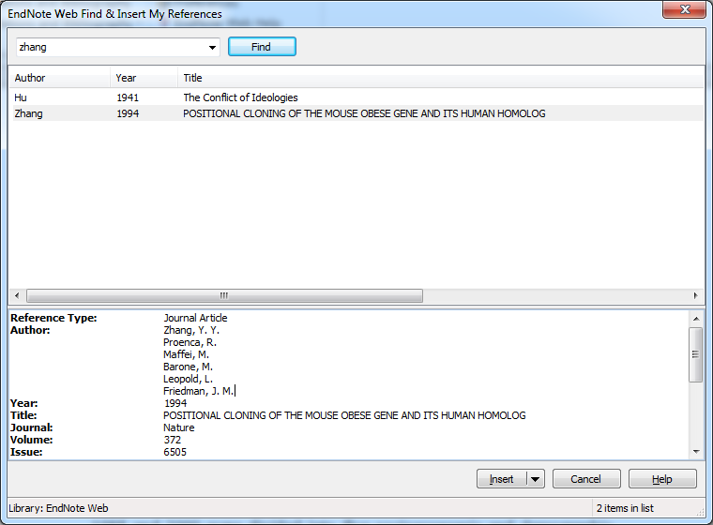
Endnote生成参考文献指南

Slide 56
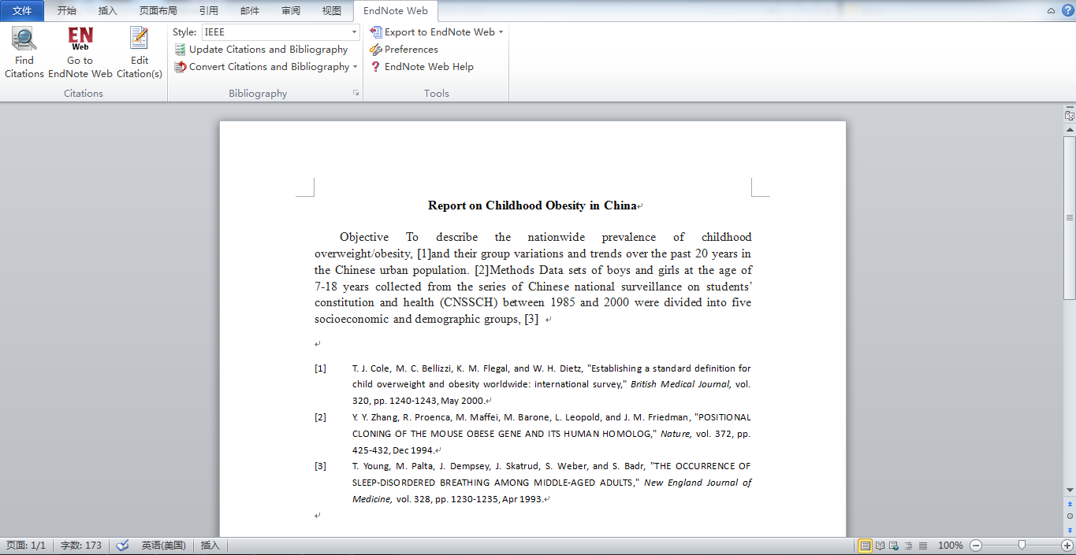
Endnote生成参考文献指南

Slide 57
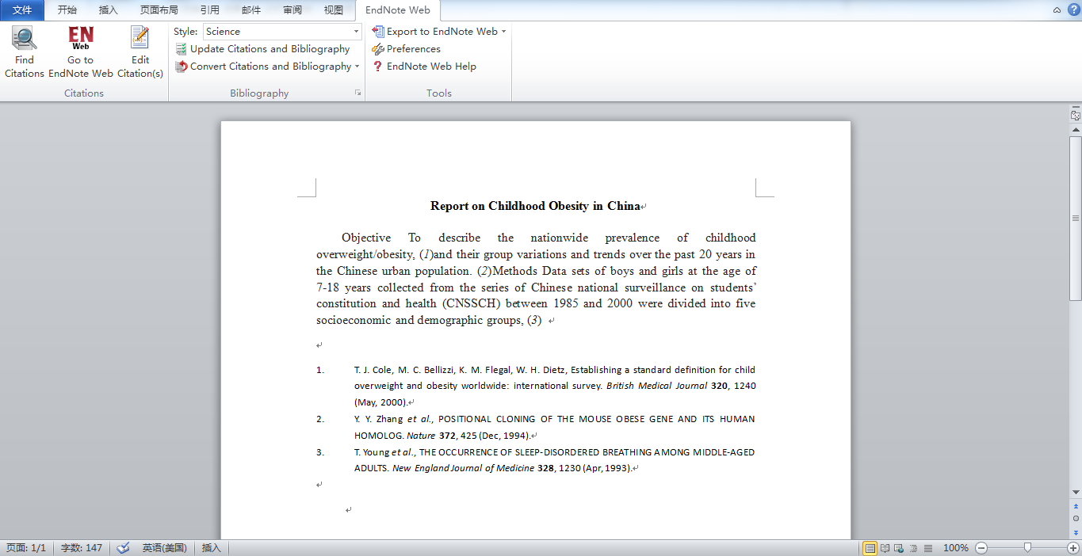
Endnote生成参考文献指南

Slide 58
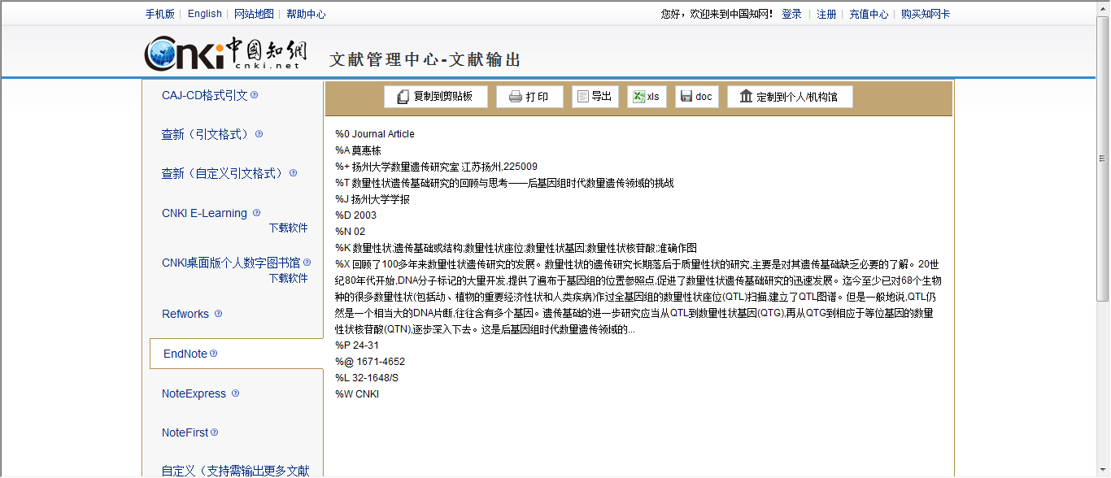
将其他数据库中的文献记录导入到Endnote

Slide 59
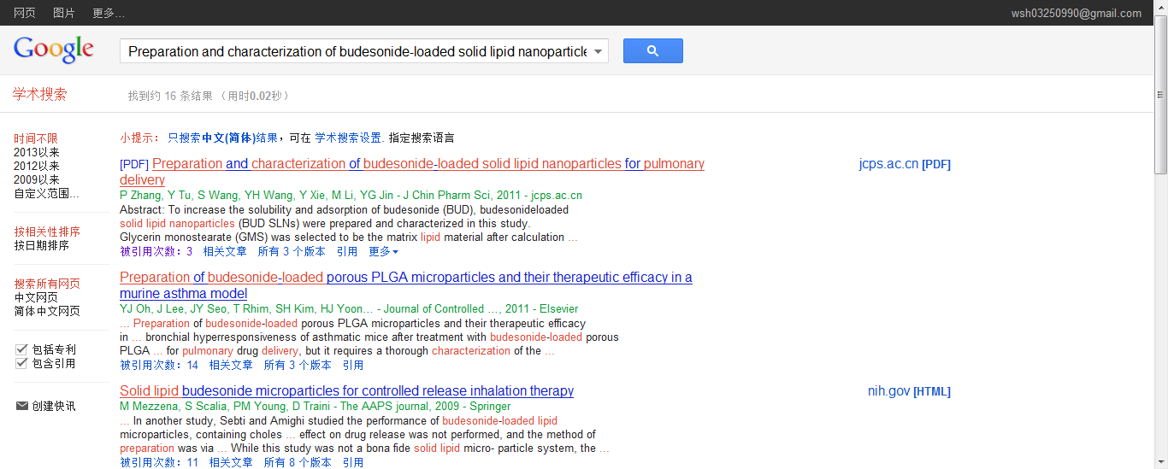
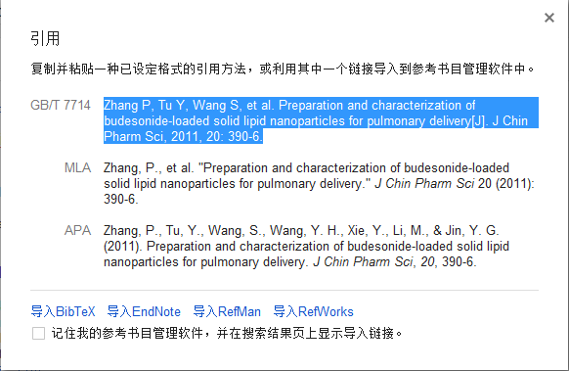
从Google Scholar中导入

Slide 60
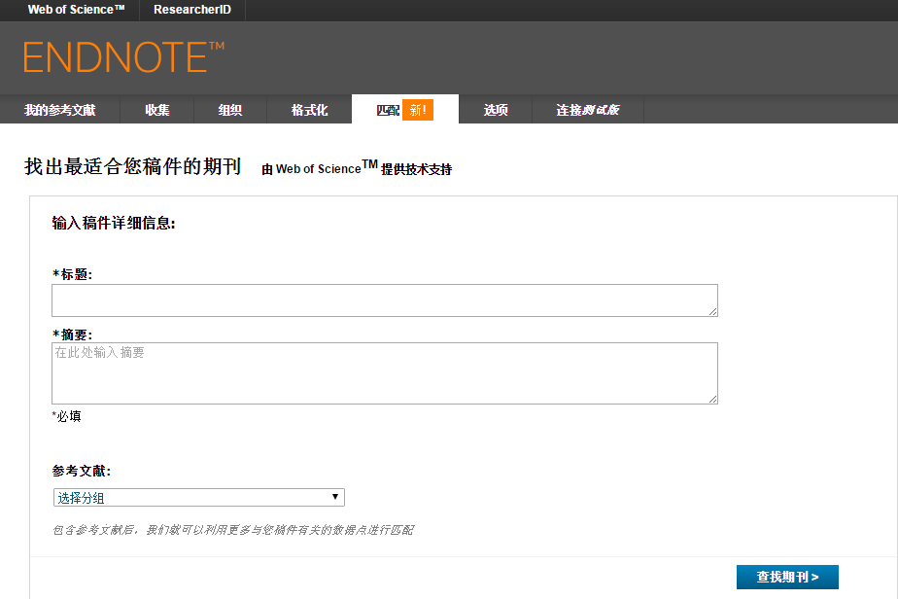
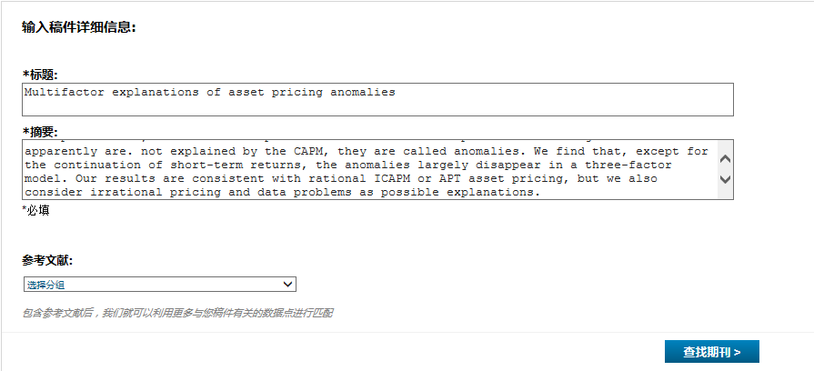
推荐合适期刊，提高投稿成功率

Slide 61
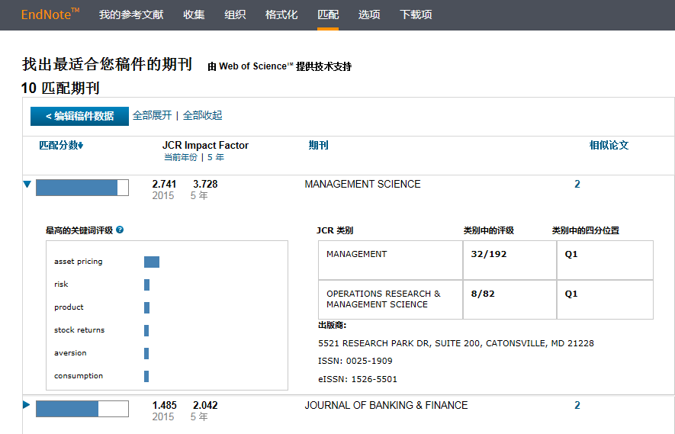
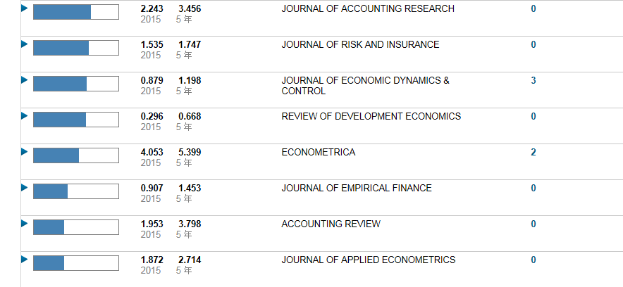
ENDNOTE匹配功能-找到最合适您投稿的期刊

Slide 62
如何使用Journal Citation Report选择期刊投稿

Slide 63
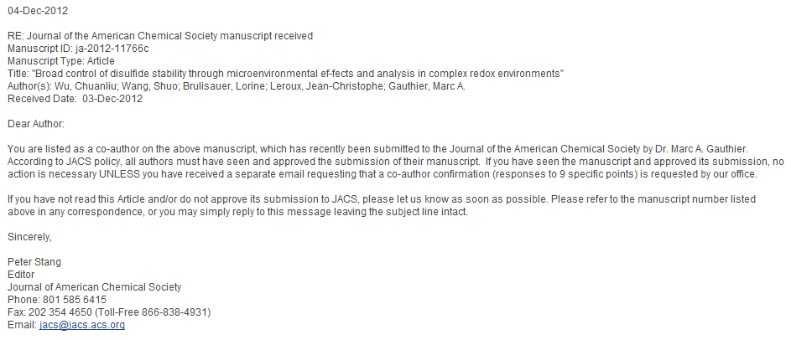
最开始的时候收到期刊的邮件总会很兴奋

Slide 64
不过有的时候啊，投稿总是被莫名其妙的拒绝掉 “您的文章……，但是本刊是……。您文章中的xxxx是非常非常出色的……”

Slide 65
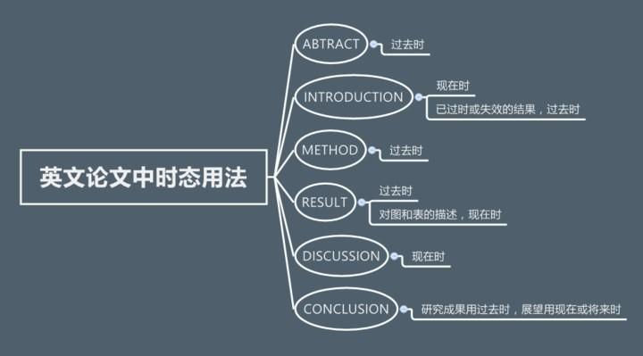
第一种情况，仅仅是因为格式和行文

Slide 66
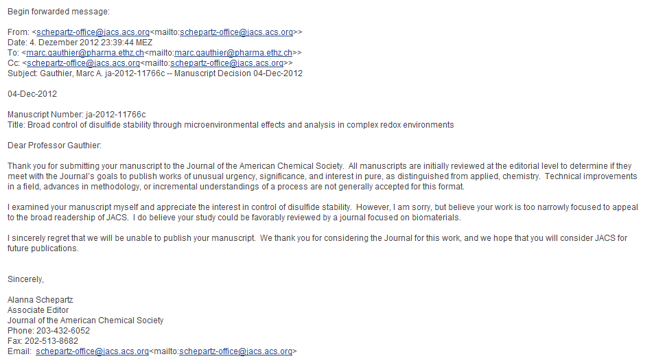
第二种情况，就是和他认为的读者群体关注有偏差

Slide 67
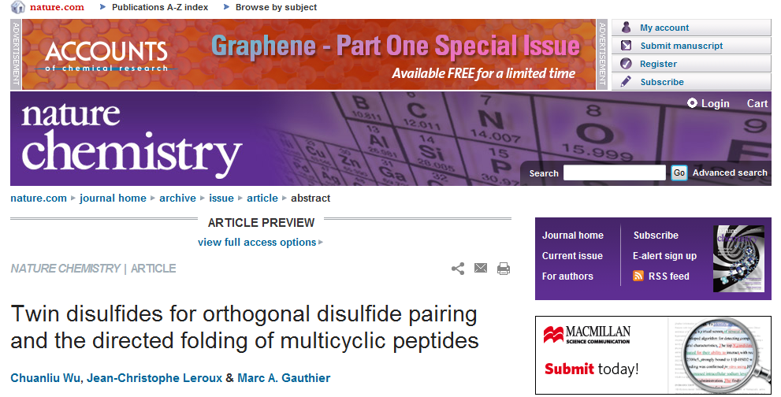
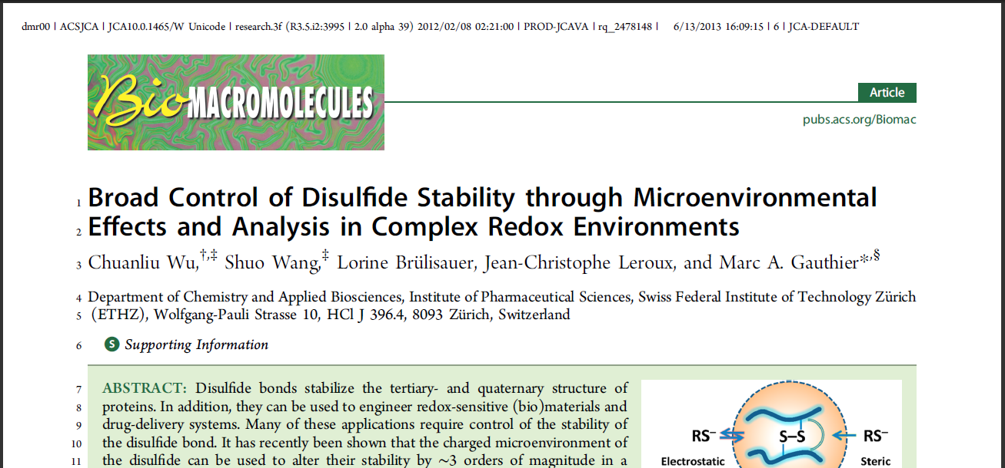
你可能猜中了开始，却没猜中结局……

Slide 68
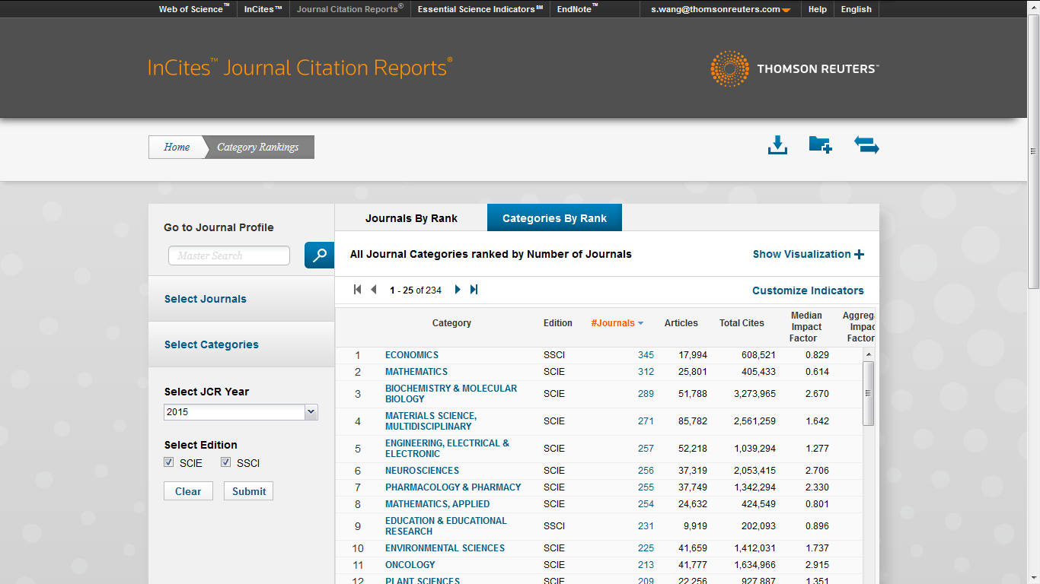

Slide 69
在经济学学科里根据影响因子对期刊进行排序

Slide 70
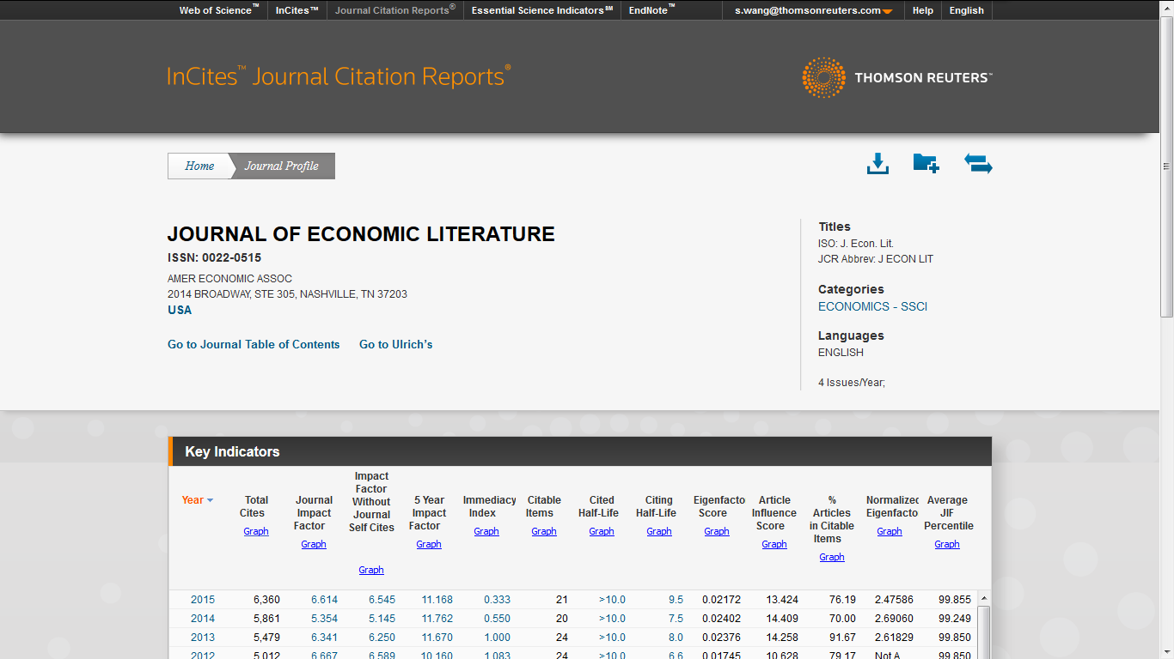
期刊的详细信息

Slide 71
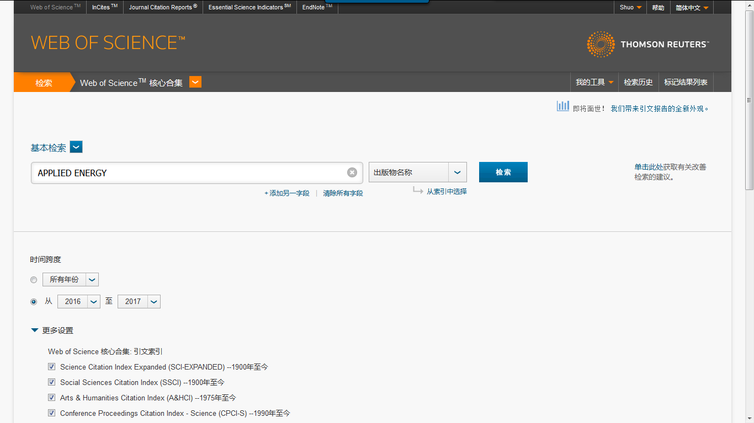
寻找相关专家，咨询建议，科研合作

Slide 76
谢谢各位老师
欢迎批评指正
王硕
Mobile:18710078551
Email: s.wang@clarivate.com
Wechat:494938351

